Slide 1
Seasonality Clustering A Hierarchical Agglomerative Approach
Intern Project – Summer 2025
08/13/2025
Adam Mahmoud

Slide 2
Background & Context
Current pricing regressions incorporate seasonality through 13 uniform quad periods per year, roughly aligned to holidays.
Quad boundaries may misalign with true demand patters → risk of capturing noise instead of seasonality
Clustering weeks into fewer data-driven seasons can:
Better reflect actual demand trends
Reduce model complexity & collinearity
Improve interpretability
Bases season definitions on client-specific data

Slide 3
Executive Summary
Problem Statement: How can we replace fixed quad-period seasonality with data-driven seasonal clusters to reduce pricing regression complexity and capture true demand variation.
Hierarchical Agglomerative Clustering
Base Dollar Velocity
Base Dollar Velocity & Time
Evaluation Metrics
Silhouette Score, Calinski-Harabasz (CH) Index, Davies-Bouldin (DB) Index
Dendrogram
Silhouette Plot
Velocity & Time Clustering only: Silhouette Score vs. Alpha plots
Regressions
Compare Demand Indices and regression model metrics between pricing regressions that:
do not use period
use standard quad-periods
use clustered periods

Slide 4
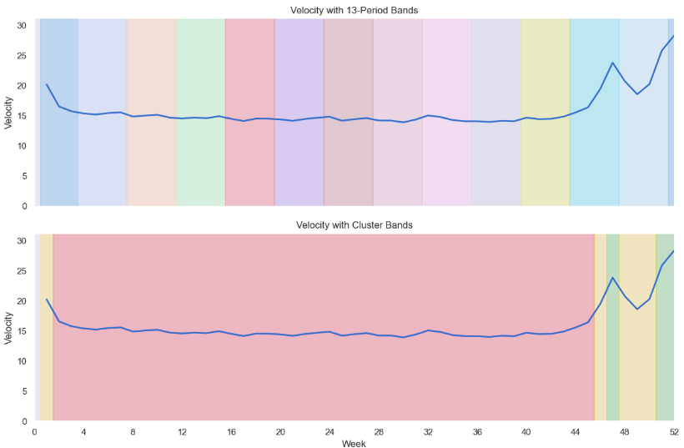
Visual Overview: Quad Periods vs. Clustered Seasons – Martinelli’s Data
IRI Data, Martinelli’s 2022-2024 Weekly (Year-over-Year Aggregated) – Total US - Food
Notes:
Make it three lines, each year

Slide 5
Data & Attributes
Datasets for building clustering pipeline:
Chomps (low seasonality)
TruFru (medium seasonality)
Martinelli’s (high seasonality)
Attributes:
Account: Total US Food
Base Dollar Velocity: Base Dollars / Stores Selling / Weeks in Distribution
Velocity is aggregated over multiple years
Note: Database baselines are used
Notes:
Category vs brand. Why did we make those distinction

Slide 6
Methodology
Hierarchical agglomerative clustering
Clustering on velocity
Clustering on velocity & time
Alpha optimization
Regression Validation

Slide 7
Hierarchical Agglomerative Clustering
Unsupervised machine learning: no input-output pairs, no period labels on week numbers
Agglomerative: every data point in its own cluster → merge similar pairs of clusters until 1 is left
Linkage Criterion: methods for deciding the order of cluster combinations
Single, complete, average, weighted, centroid, median, ward
GIF Source: Makkar, Vast Data Deduction (students x students, 2022)

Slide 8
Cluster Evaluation Metrics
Dendrogram: tree diagram showing how clusters merge step-by-step; merge height reflects the distance between joined clusters.
Silhouette Score: measures how similar a point is to its own cluster compared to other clusters. Ranges from -1 (poor fit) to 1 (well separated); higher is better.
CH Index: ratio of between-cluster variance to within-cluster variance, adjusted for number of clusters. Higher values indicate better defined clusters.
DB Index: measures average similarity between each cluster and its most similar other cluster; lower values indicate tighter, more distinct clusters.

Slide 9
Clustering on Velocity
Case Study: Chomps
Takeaway: Narrow focus to Single Linkage & Silhouette Score

Slide 10
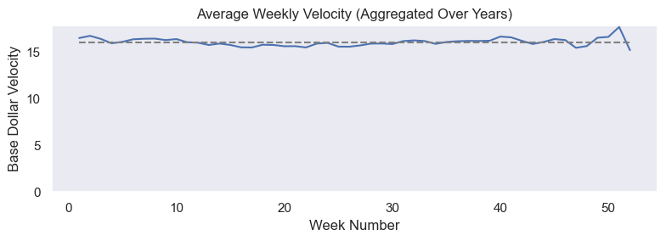
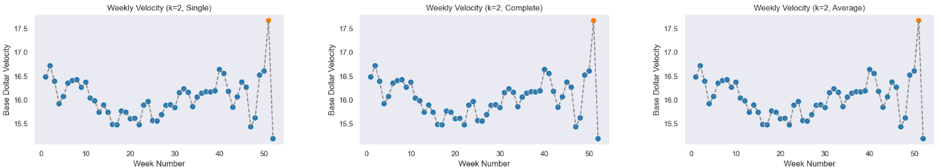
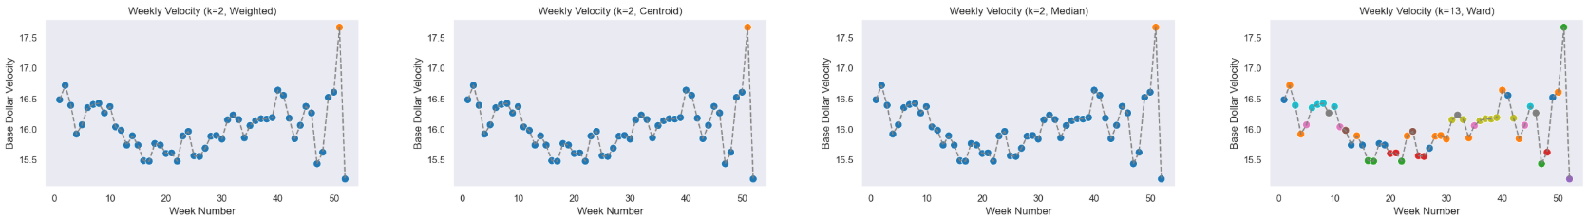
Chomps – Velocity Clustering
Note: k_max = 13
IRI Data, Chomps L156 WE 2/23/25 (Year-over-Year Aggregated) – Total US - Food

Slide 11
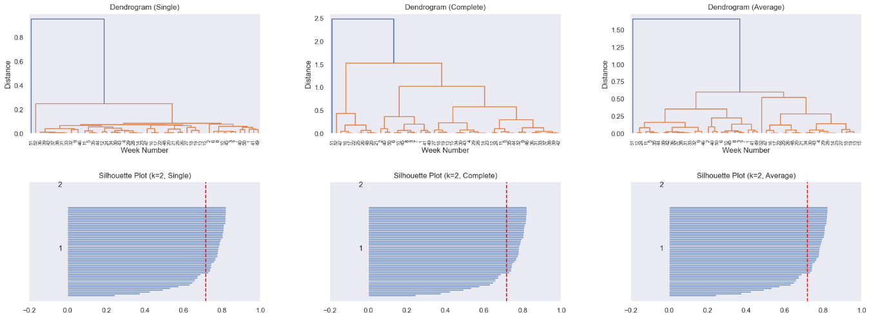
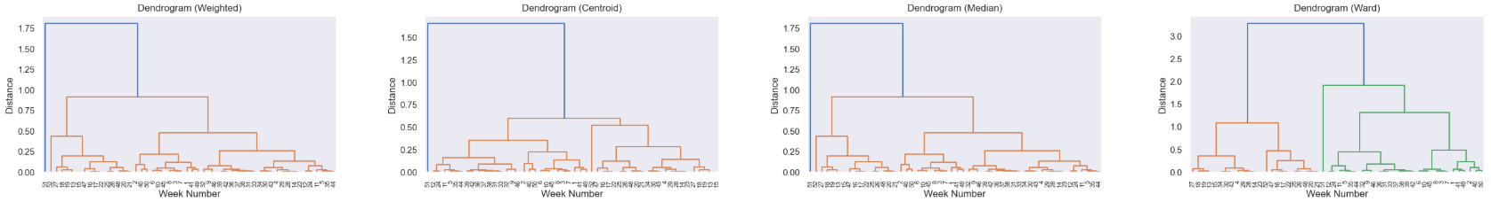
Chomps – Dendrograms
Note: k_max = 13
IRI Data, Chomps L156 WE 2/23/25 (Year-over-Year Aggregated) – Total US - Food

Slide 12
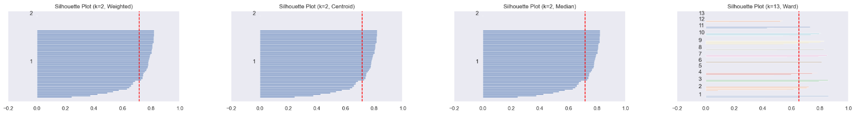
Chomps – Silhouette Plots
Note: k_max = 13
IRI Data, Chomps L156 WE 2/23/25 (Year-over-Year Aggregated) – Total US - Food

Slide 13
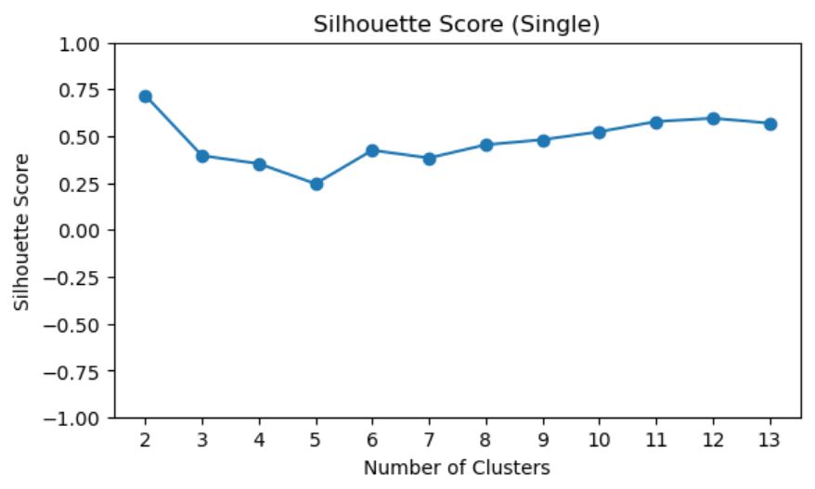
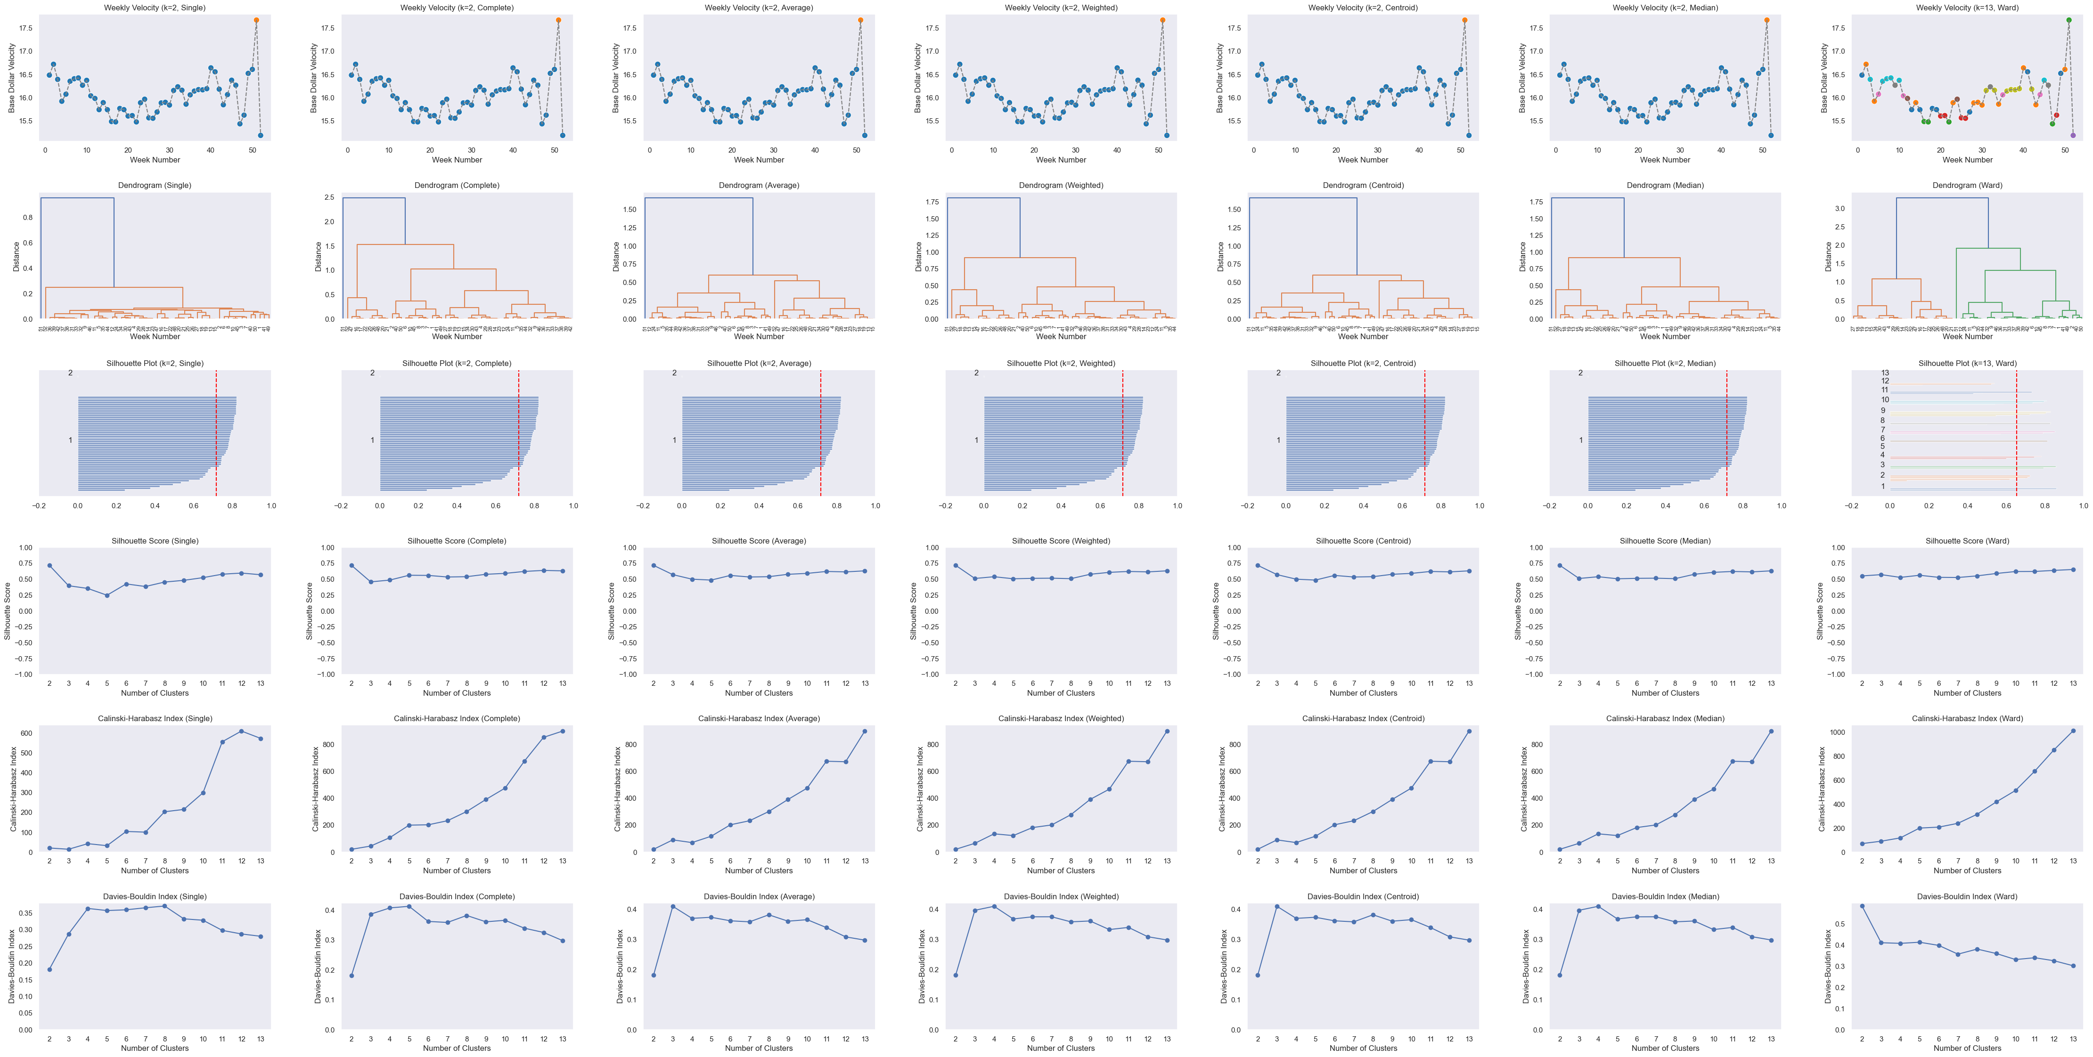
Chomps – Silhouette Score, CH Index, DB Index by Number of Clusters
Note: k_max = 13
IRI Data, Chomps L156 WE 2/23/25 (Year-over-Year Aggregated) – Total US - Food

Slide 14
Clustering on Velocity & Time
Case Study: TruFru
Takeaway: Incorporating time in a custom distance function typically worsens clustering

Slide 15
Custom Distance Functions Tested
Linear: Combines normalized week difference and velocity difference with a weighted average
Squared Velocity: Same as linear, but velocity difference is squared to emphasize larger gaps
Exponential Decay on Time: Uses exponential decay for time difference, making nearby weeks much closer
Cosine Bump Distance: Gives extra closeness to weeks within 4 using a cosine curve, then switches to linear growth; piecewise function

Slide 16
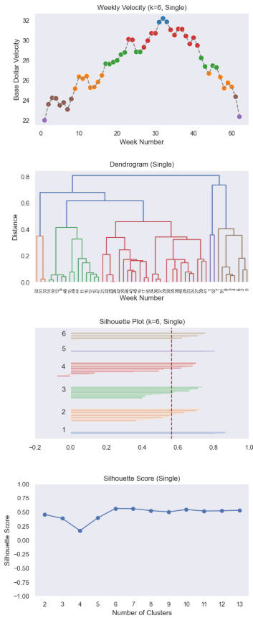
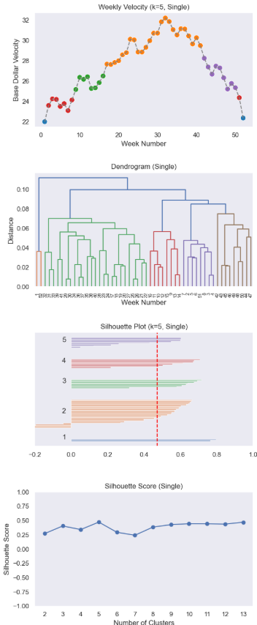
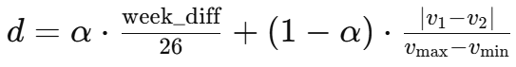
TruFru – Clustering With & Without Time
Without Time
With Time
Linear Distance Function:
Generally lower silhouette scores
Clustering with time led to an optimized silhouette score at a lower number of clusters
where α = 0.2
IRI Data, TruFru L156 WE 1/5/25 (Year-over-Year Aggregated) – Total US - Food

Slide 17
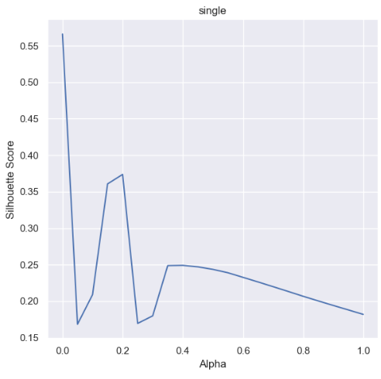
TruFru – Increasing Alpha (putting more weight to the time component in calculating distance) generally worsens average silhouette score
Linear distance function
Single linkage
Number of Clusters = 6
IRI Data, TruFru L156 WE 1/5/25 (Year-over-Year Aggregated) – Total US - Food

Slide 18
Assessing Results with Pricing Regressions
Case Study: Martinelli’s
Takeaway: Clustered seasons can help improve regression R-squared

Slide 19
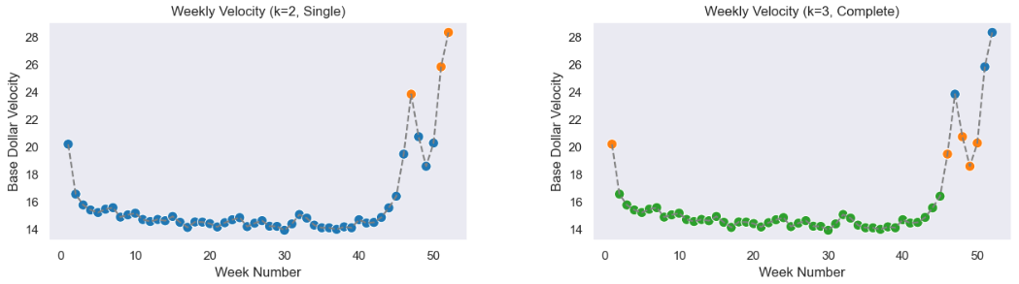
Martinelli’s – Complete linkage appears to cluster seasons more effectively in this case
IRI Data, Martinelli’s L156 WE 12/29/24 (Year-over-Year Aggregated) – Total US - Food

Slide 20
Martinelli’s – Clustered periods yield highest R-squared in pricing regression
No Period Factor: np.log(Q('Base Units')) ~ PriceFactor + np.log(Q('ACV')) + AccountFactor
13-Periods Factor: np.log(Q('Base Units')) ~ PriceFactor + np.log(Q('ACV')) + AccountFactor + PeriodFactor
3 Clusters Period Factor: np.log(Q('Base Units')) ~ PriceFactor + np.log(Q('ACV')) + AccountFactor + ClusteredPeriodFactor
Regression on single SKU: Martinelli’s Gold Medal Apple Sparkling Cider – Glass Bottle, 25.4 oz (1 ct)
IRI Data, Martinelli’s L156 WE 12/29/24 – Food Channel Lowers

Slide 21
Seasonality Coefficients
2.07
0.67
0.26
IRI Data, Martinelli’s 2022-2024 Weekly (Year-over-Year Aggregated) – Total US - Food
Notes:
Label y axis properly – dollar velocity

Slide 22
Challenges
Mapping week numbers across multiple years and aligning holidays consistently
Many parameters that need to be optimized are at play:
Number of clusters
Linkage criteria
Custom distance metric
Alpha value (time vs. velocity weight in chosen custom distance metric)
Choice of evaluation metric (Silhouette, CH, DB, regression-based)
Hard to make a definitive conclusion on impact. Benefits of clustering do not appear to be consistent across datasets and metrics

Slide 23
Continuations
Pipeline
Implement Python code into Excel for consolidated processing-clustering-regression pipeline.
Regressions
Determine optimal cluster assignments by maximizing adjusted R-squared or minimizing collinearity metrics (e.g., variance inflation factor, condition number).
Run the regression pipeline on additional datasets to better quantify the impact of weekly clustering on pricing regressions.
Compare elasticity predictions from the standard model vs. the clustered model using pre–price-increase data and evaluate which one performs better.
Time-Continuous Seasons
Explore Markov-constrained clustering to enforce that weeks in the same season are contiguous in time.
Continue developing and testing custom distance formulas that blend velocity difference with week difference.
Extending Beyond Seasonality – DAFI-Gower Clustering (Liu et al., 2024)
Apply a modified Gower distance that balances the influence of different variable types (numeric, categorical, binary) by scaling them to comparable ranges and weighting them by their importance.
Potential variables: velocity, product attributes (package size, flavor, category), promo status, ACV, and account/channel type.
Notes:
Tie it all back to regressions

Slide 24
Acknowledgements
Sean Dunbar
William Dumas
Hazel McCarthy
Bob Dumas
Diana Constantinescu

Slide 25
References
Liu, P., Yuan, H., Ning, Y. et al. A modified and weighted Gower distance-based clustering analysis for mixed type data: a simulation and empirical analyses. BMC Med Res Methodol 24, 305 (2024). https://doi.org/10.1186/s12874-024-02427-8
Makkar, A. (2022, December 10). Vast Data Deduction: Insight on how a Computer Pinpoints Data. students x students. Retrieved August 12, 2025, from https://studentsxstudents.com/vast-data-deduction-insight-on-how-a-computer-earmarks-data-af51f9870b58
Pedregosa, F., et al. (2011). Scikit-learn: Machine Learning in Python. Journal of Machine Learning Research, 12, 2825–2830. Retrieved August 12, 2025, from https://scikit-learn.org/stable/modules/clustering.html
Virtanen, P., et al. (2025). scipy.cluster.hierarchy.linkage (v1.16.1) [Documentation]. SciPy. Retrieved August 12, 2025, from https://docs.scipy.org/doc/scipy/reference/generated/scipy.cluster.hierarchy.linkage.html

Slide 26
Appendix

Slide 27

Chomps – Clustering on Velocity
IRI Data, Chomps L156 WE 2/23/25 (Year-over-Year Aggregated) – Total US - Food

Slide 28
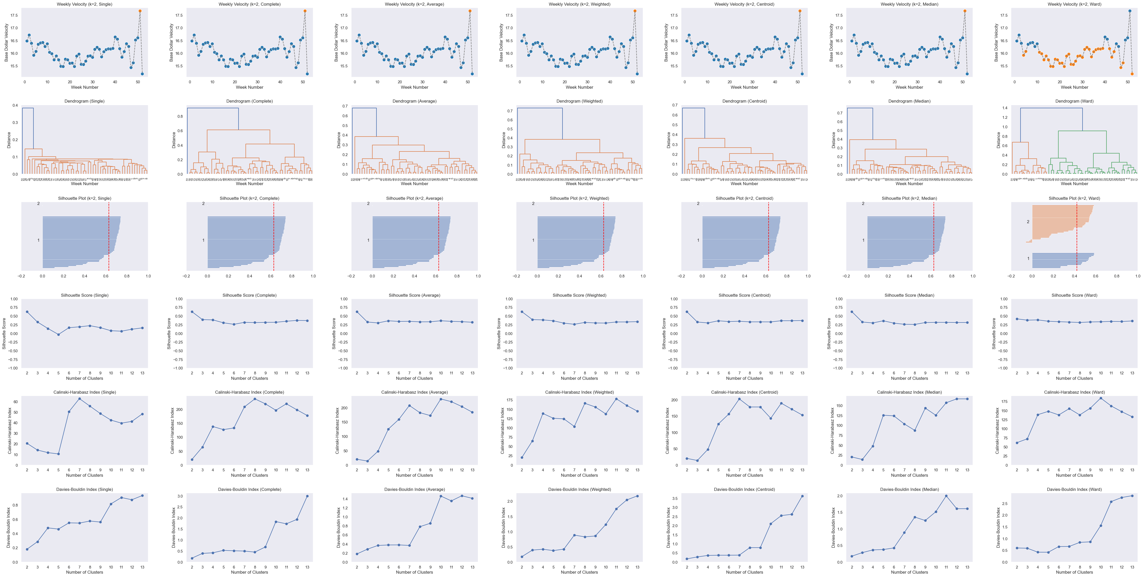
Chomps – Clustering on Velocity & Time (alpha = 0.1, exp. decay distance function)
IRI Data, Chomps L156 WE 2/23/25 (Year-over-Year Aggregated) – Total US - Food

Slide 29
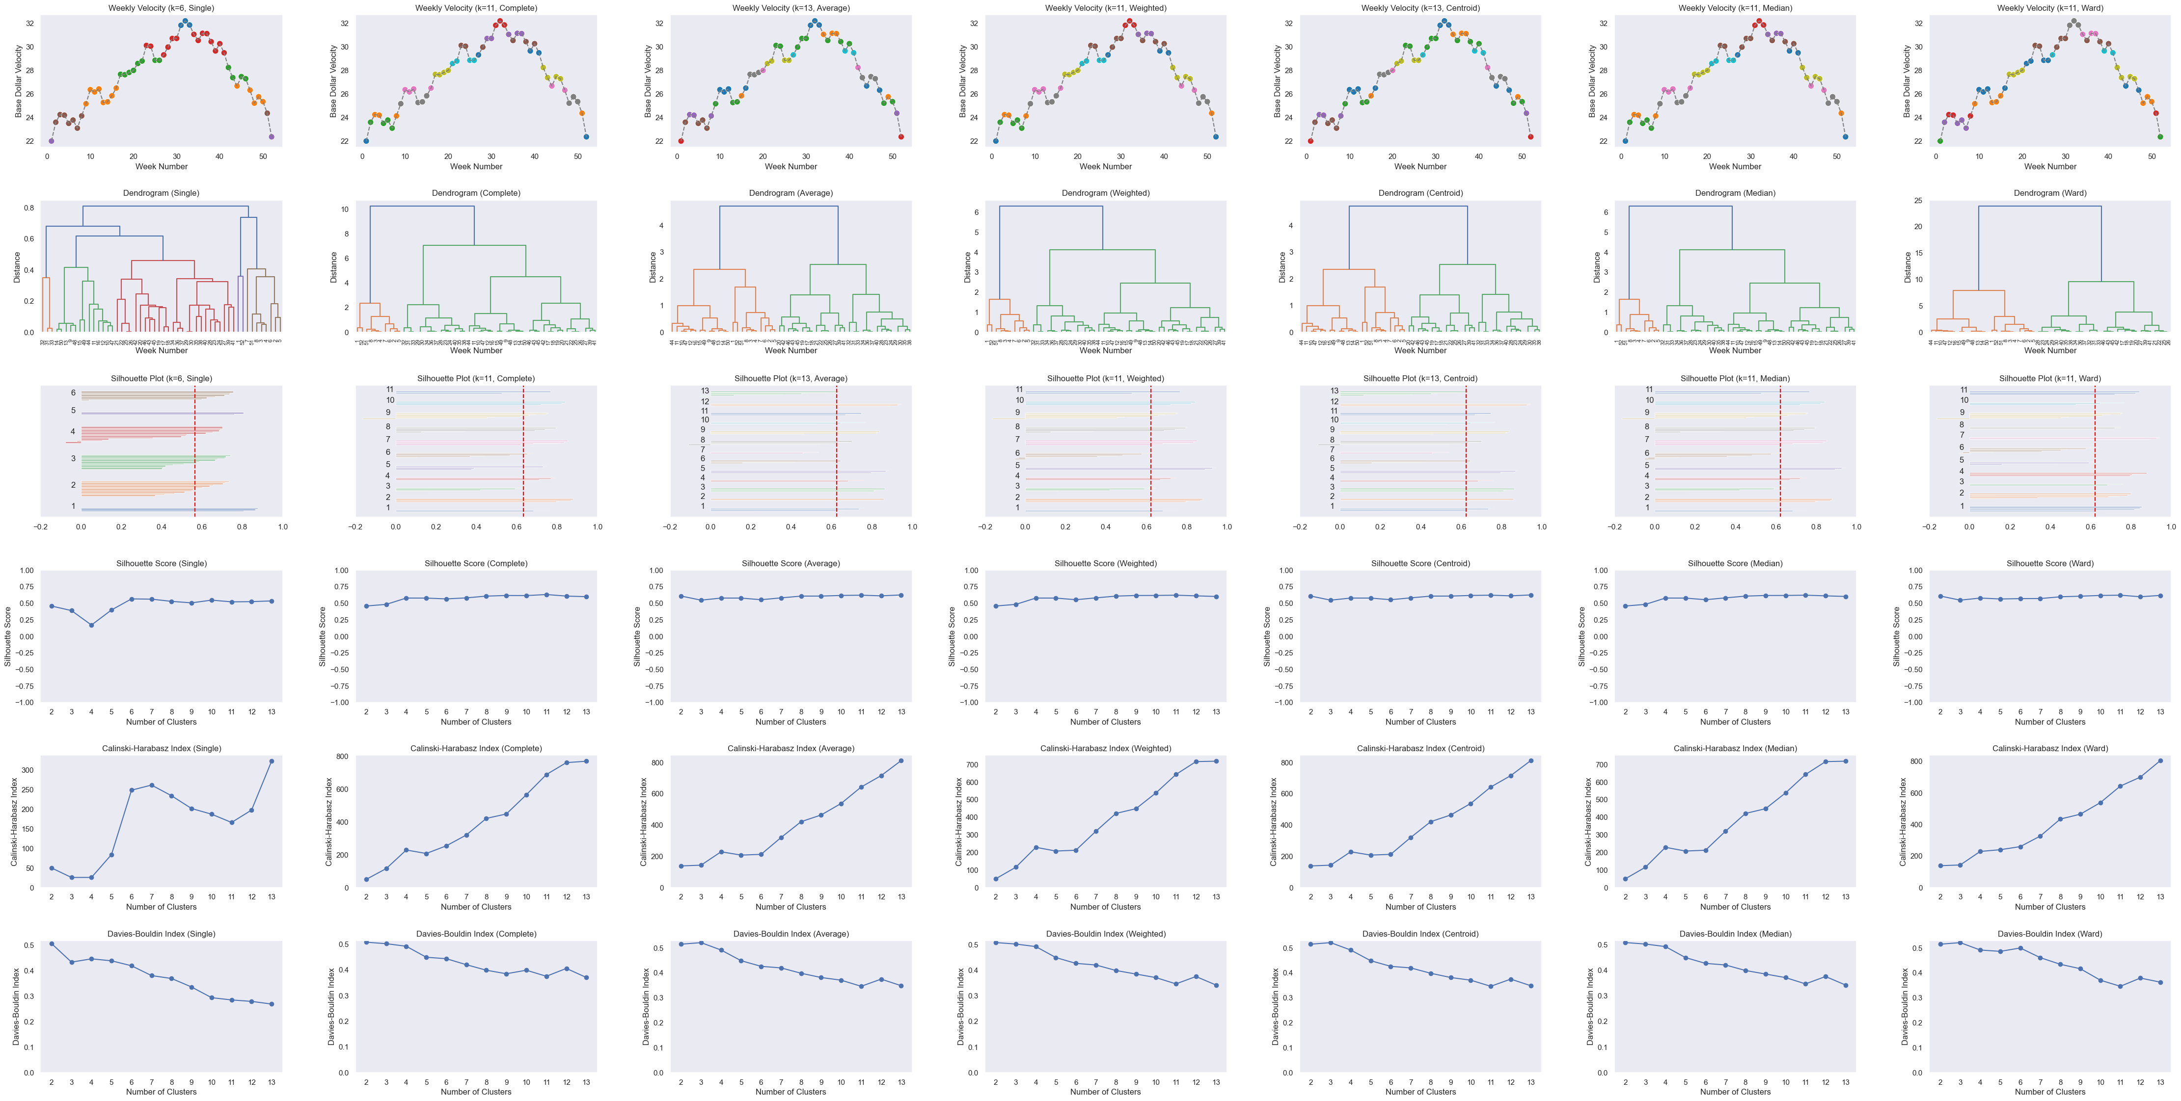
TruFru – Clustering on Velocity
IRI Data, TruFru L156 WE 1/5/25 (Year-over-Year Aggregated) – Total US - Food

Slide 30
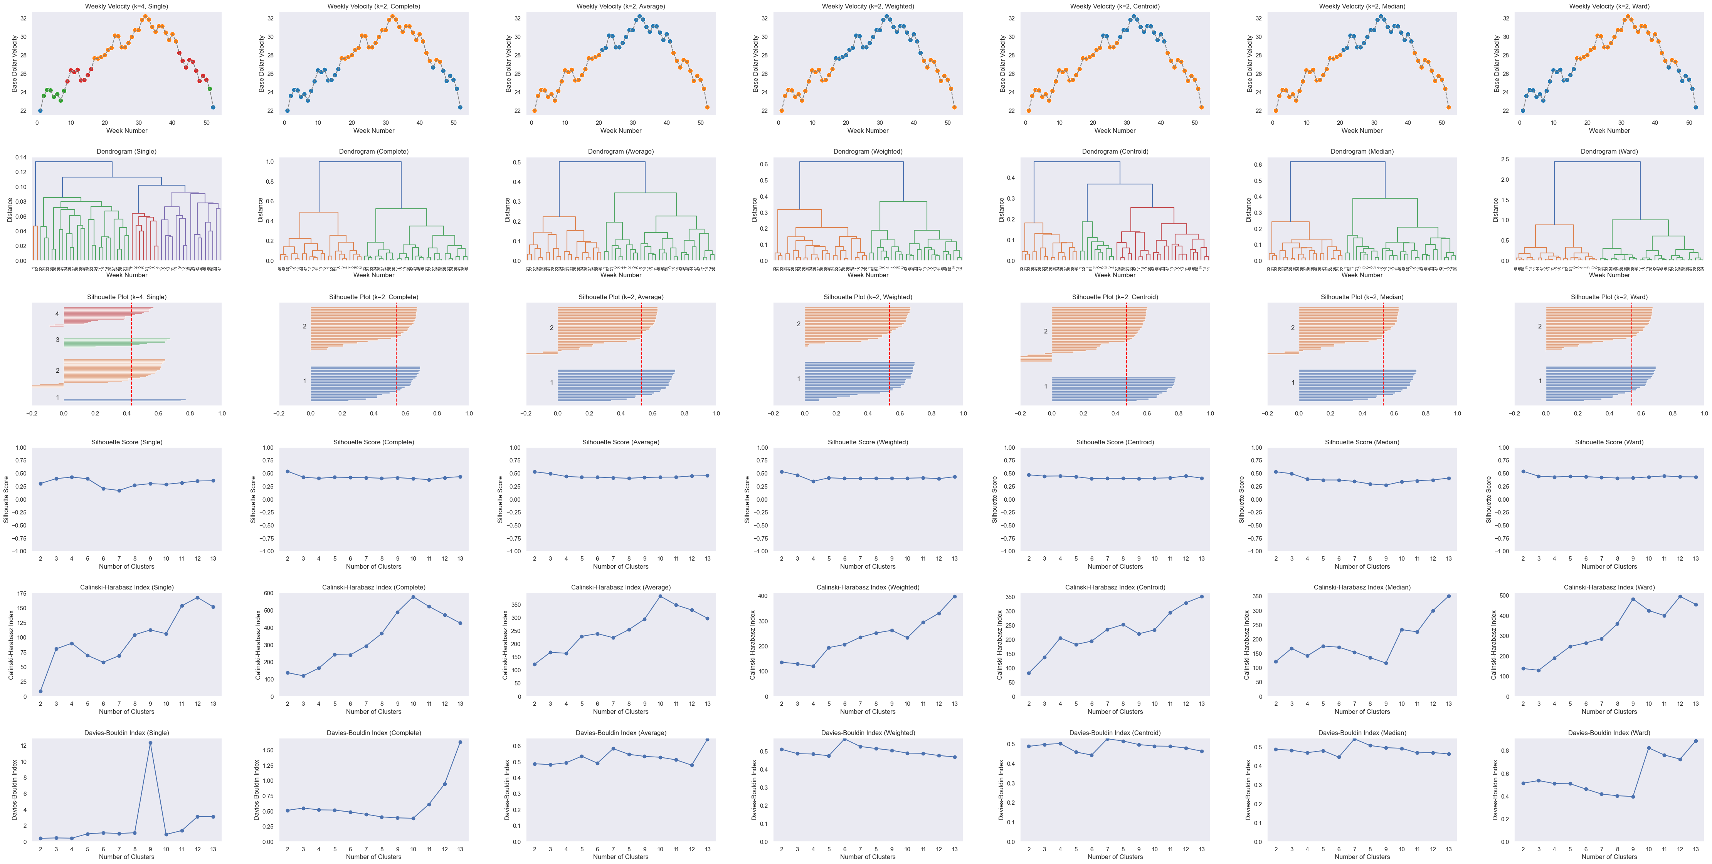
TruFru – Clustering on Velocity & Time (alpha = 0.1, exp. decay distance function)
IRI Data, TruFru L156 WE 1/5/25 (Year-over-Year Aggregated) – Total US - Food

Slide 31
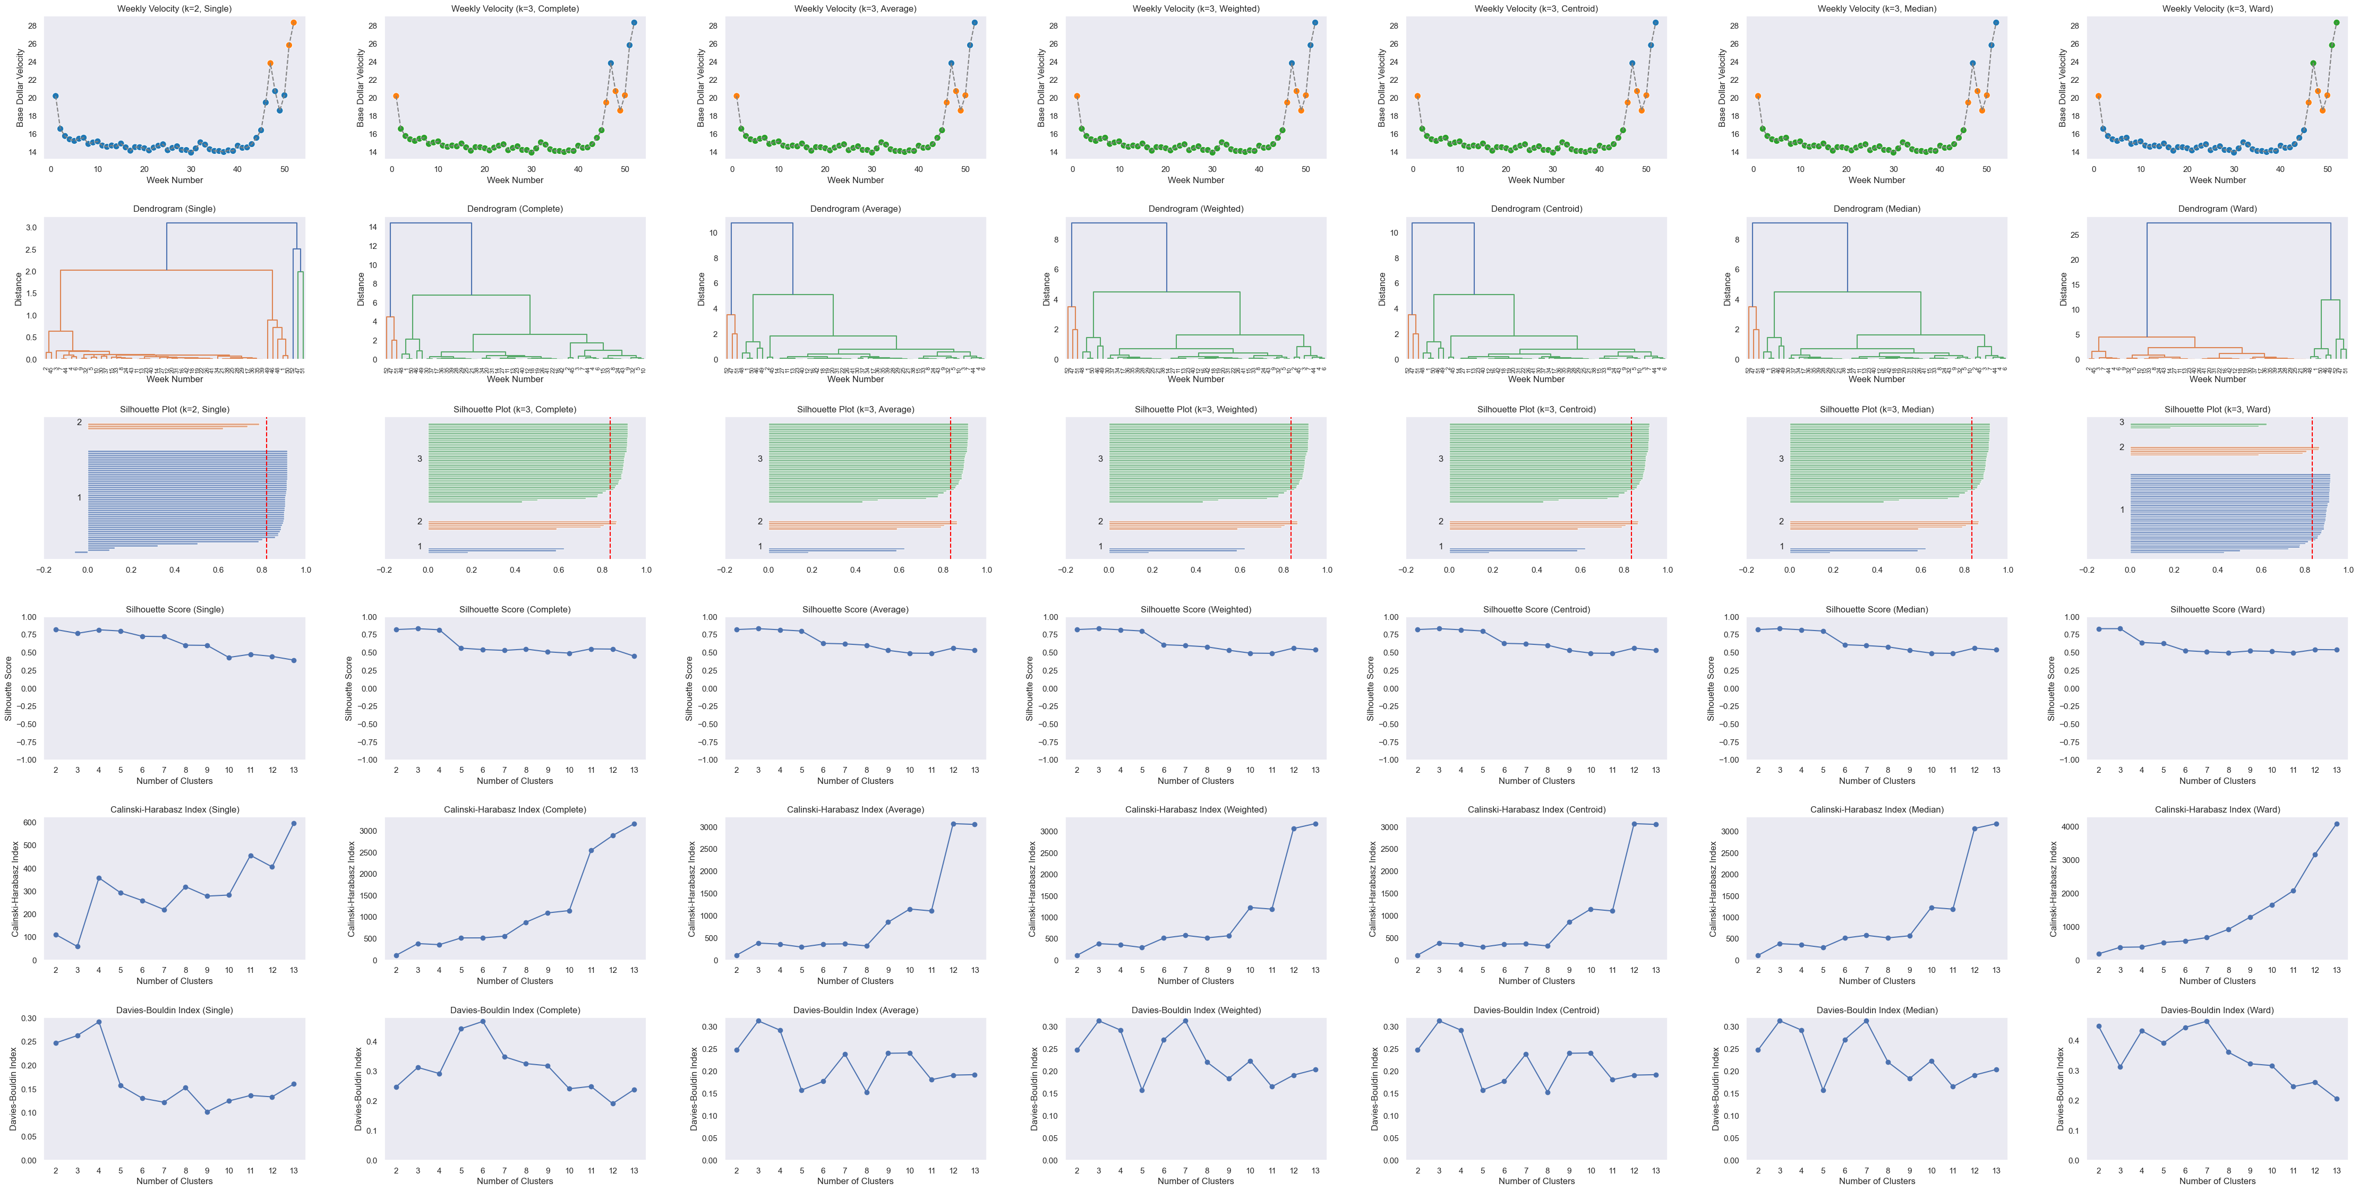
Martinelli’s – Clustering on Velocity
IRI Data, Martinelli’s L156 WE 12/29/24 (Year-over-Year Aggregated) – Total US - Food

Slide 32
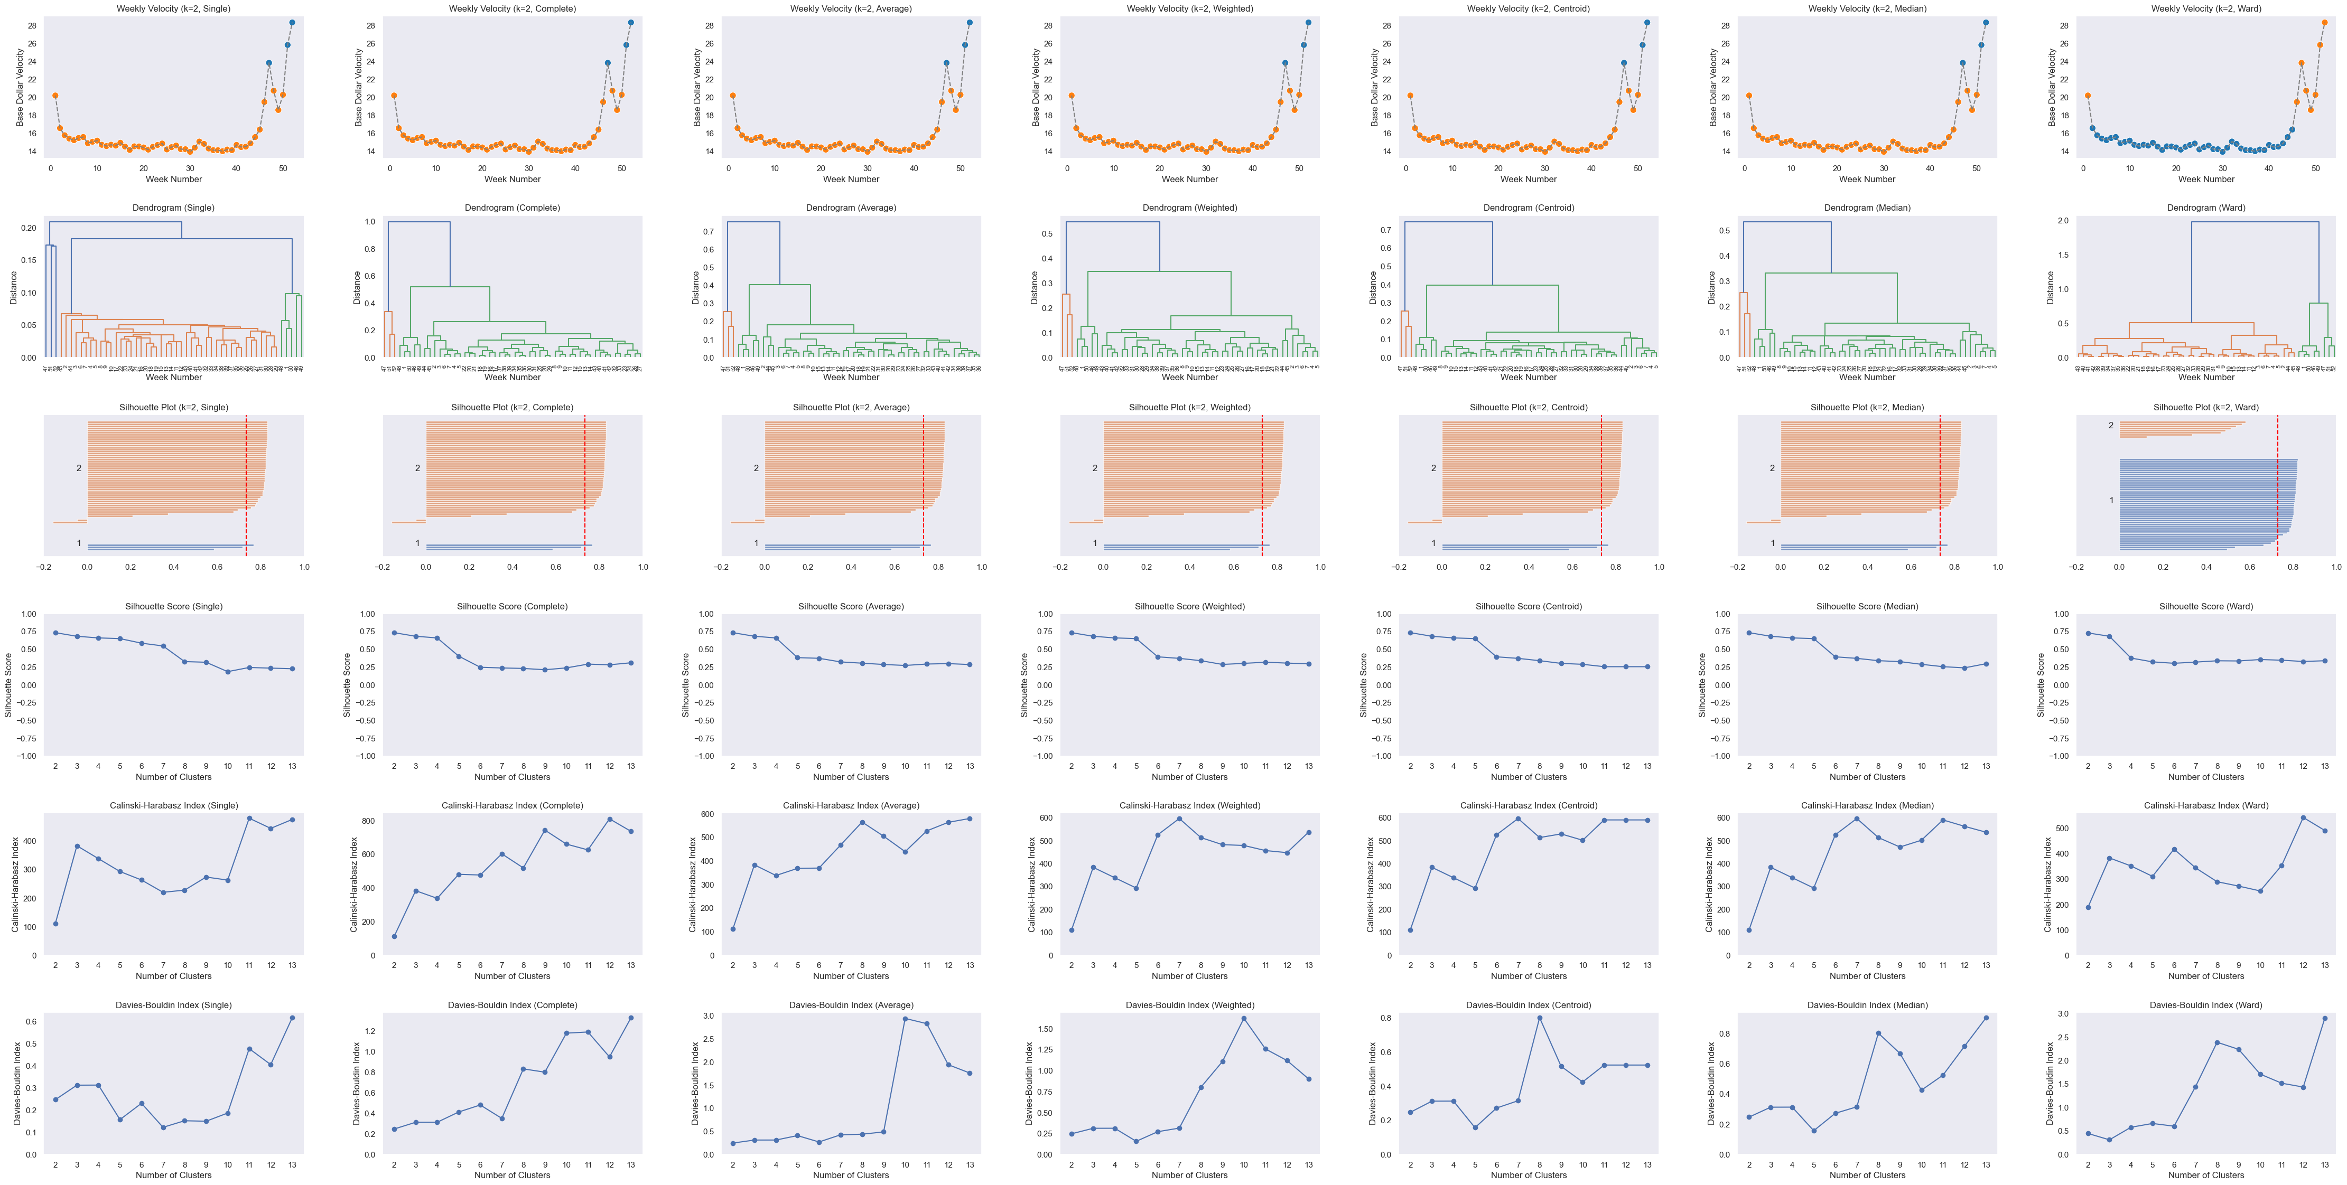
Martinelli’s – Clustering on Velocity & Time (alpha = 0.1, exp. decay distance function)
IRI Data, Martinelli’s L156 WE 12/29/24 (Year-over-Year Aggregated) – Total US - Food

Slide 33
Linkage Criterion
Single linkage – Distance between two clusters = shortest distance between any two points (nearest neighbor). Can create “chained” clusters.
Complete linkage – Distance = farthest distance between any two points (furthest neighbor). Produces compact, evenly shaped clusters.
Average linkage – Distance = average of all pairwise distances between points in the two clusters. Balances chaining and compactness.
Weighted linkage – Like average linkage but updates distances with equal weight to each existing cluster, regardless of size.
Centroid linkage – Distance between clusters = distance between their centroids (mean vectors). Can cause reversals in dendrograms.
Median linkage – Similar to centroid but uses median instead of mean for each dimension; more robust to outliers.
Ward’s linkage – Merges clusters that result in the smallest increase in total within-cluster variance; tends to create clusters of similar size.

Slide 34
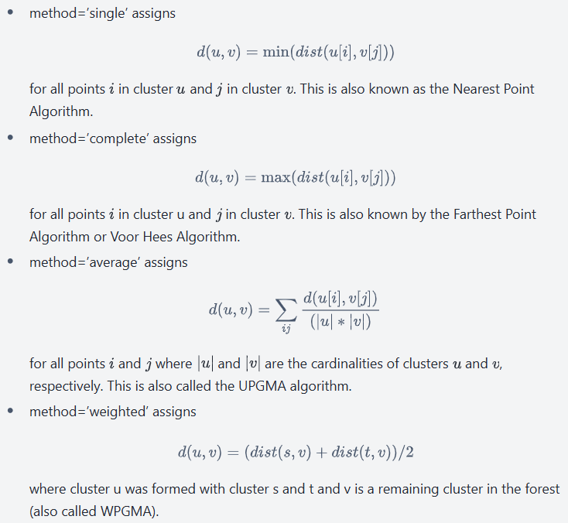
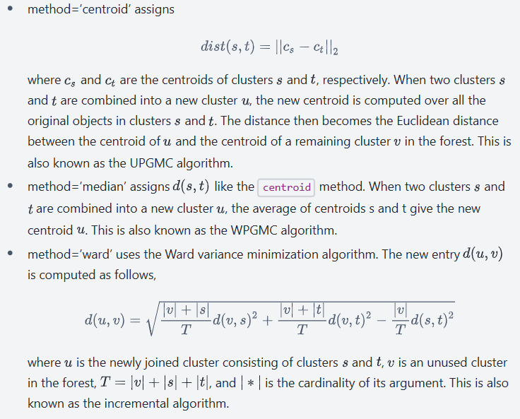
Linkage Criterion – SciPy Documentation
Source: SciPy v1.16.1 documentation

Slide 35
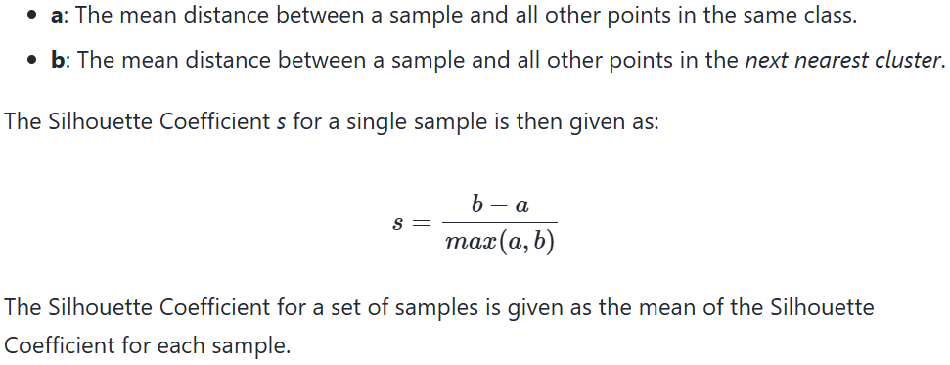
Cluster Evaluation Metrics – scikit-learn Documentation
Silhouette Score
Source: Source: scikit-learn documentation — Clustering performance evaluation

Slide 36
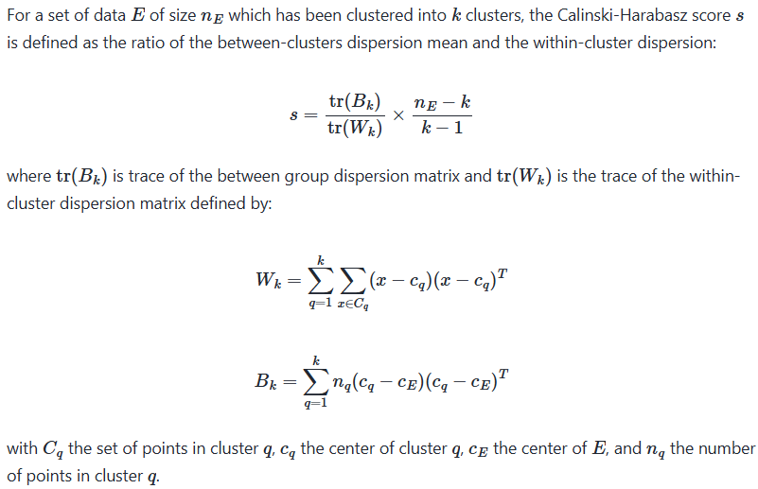
Cluster Evaluation Metrics – scikit-learn Documentation
CH Index
Source: Source: scikit-learn documentation — Clustering performance evaluation

Slide 37
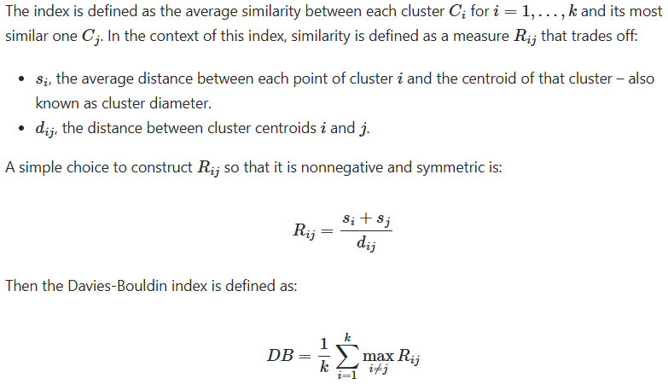
Cluster Evaluation Metrics – scikit-learn Documentation
DB Index
Source: Source: scikit-learn documentation — Clustering performance evaluation

Slide 38
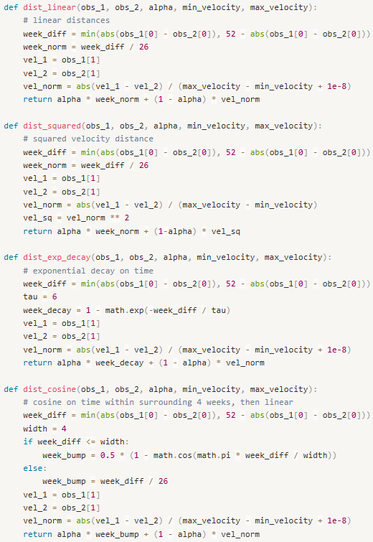
Custom Distance Functions

